Slide 1
Unit - 1 [B]
File Handling

Slide 2
topic
Concept of data files
File handling
Use of file handling functions
fopen, fclose, fprintf, fscanf, getw, putw, fseek,
ftell, rewind ,freopen, remove, rename, feof, ferror
I/O operations
Command line arguments

Slide 3
Concept of data files
What is the concept of files in data structure?
File is a collection of records related to each other.
What is a data file with example?
A data file is any file containing information, but not code; it is only meant to be read or viewed and not executed.
What are the 3 types of file structure?
Three types of files structure in OS:
A text file: It is a series of characters that is organized in lines.
An object file: It is a series of bytes that is organized into blocks.
A source file: It is a series of functions and processes.

Slide 4
File Handling
File Handling is the storing of data in a file using a program.
The operations that you can perform on a File in DS are −
Creating a new file
Opening an existing file
Reading data from an existing file
Writing data to a file
Moving data to a specific location on the file
Closing the file

Slide 5
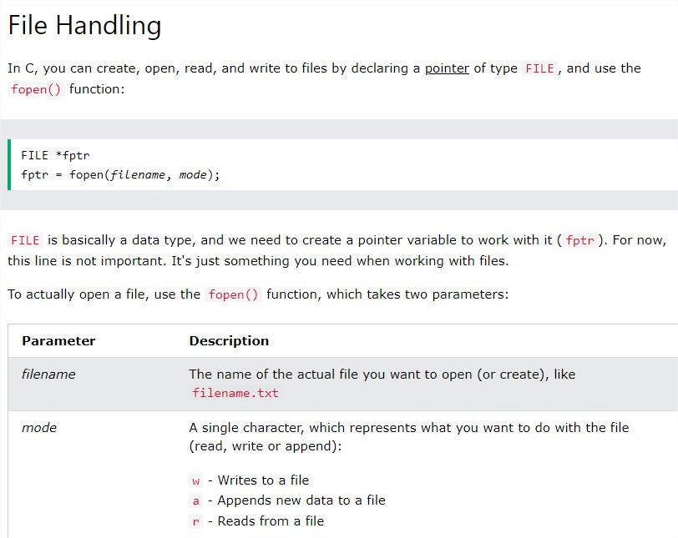

Slide 6
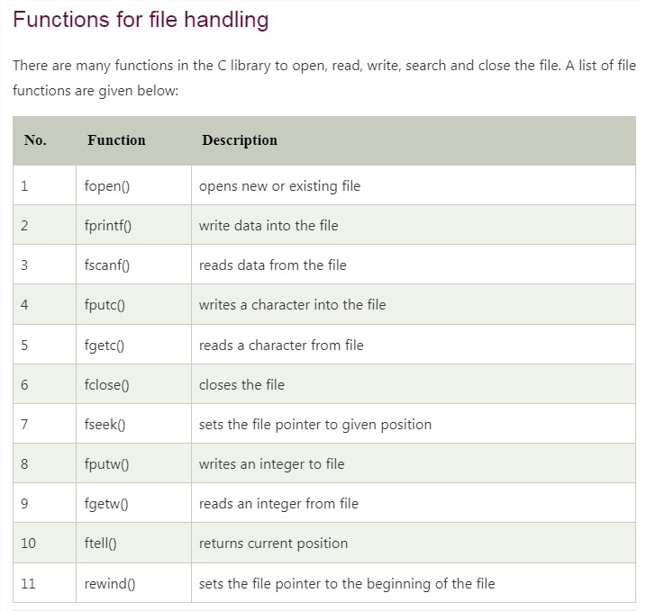
Use of file handling functions

Slide 7
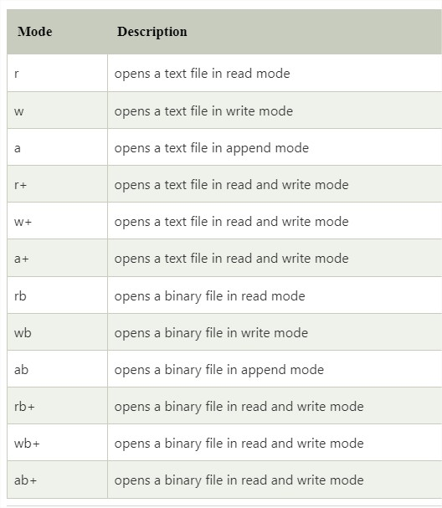

Slide 8
Create a File
To create a file, you can use the ’w’ mode inside the fopen() function.
The w mode is used to write to a file. However, if the file does not exist, it will create one for you:
Note: The file is created in the same directory as your other C files, if nothing else is specified.

Slide 9
Example: Opening File: fopen(), fclose
#include <stdio.h>
void main()
{
FILE *fptr;
// Create a file on your computer (filename.txt)
fptr = fopen("DEMO.txt", "w");
// Close the file
fclose(fptr);
// return 0;
}

Slide 10
Write To a File
The w mode means that the file is opened for writing.
you can use the fprintf() function and add the pointer variable (fptr in our example) and some text:

Slide 11
Example: Opening File: fopen(), fclose(), fprintf()
#include <stdio.h>
void main()
{
FILE *fptr;
// Open a file in writing mode
fptr = fopen("filename.txt", "w");
// Write some text to the file
fprintf(fptr, "Some text");
// Close the file
fclose(fptr);
}

Slide 12
Read Files
To read from a file, you can use the r mode:
#include <stdio.h>
void main()
{
FILE *fptr;
// Open a file in read mode
fptr = fopen("demo1.txt", "r");
// Write some text to the file
fprintf(fptr, "kamani college amreli - welcome ");
// Close the file
fclose(fptr);
}

Slide 13
Writing File : fprintf() function
The fprintf() function is used to write set of characters into file. It sends formatted output to a stream.
Example :
#include<stdio.h>
void main()
{
FILE *fp;
fp=fopen("file.txt","w");//opening file
fprintf(fp,"Hello file by fprintf...\n");//writing data into file
fclose(fp);//closing file
}

Slide 14
Reading File : fscanf() function
The fscanf() function is used to read set of characters from file. It reads a word from the file and returns EOF at the end of file.
Example :
#include <stdio.h>
void main()
{
FILE *fp;
char buff[255];//creating char array to store data of file
clrscr();
fp = fopen("file.txt", "r");
while(fscanf(fp, "%s", buff)!=EOF)
{
printf("%s ", buff);
}
fclose(fp);
getch();
}

Slide 15
functions putw() and getw()
File is collection of records or is a place on hard disk, where data is stored permanently.
putw() is use to write integer data on the file (text file). getw() is use to read the integer data from the file. getw() and putw() are similar to getc() and putc(). The only difference is that getw() and putw() are especially meant for reading and writing the integer data.
Operations on files
The operations on files in C programming language are as follows −
Naming the file
Opening the file
Reading from the file
Writing into the file
Closing the file

Slide 16
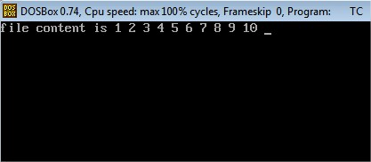
Example : putw() and getw()
#include<stdio.h>
void main( )
{
FILE *fp;
int i;
clrscr();
fp = fopen ("DEMO1.txt", "w");
for (i =1; i<= 10; i++){
putw (i, fp);
}
fclose (fp);
fp =fopen ("DEMO1.txt", "r");
printf ("file content is ");
for (i =1; i<= 10; i++)
{
i= getw(fp);
printf ("%d",i);
printf(" ");
}
fclose (fp);
getch();
}

Slide 17
function - fseek(), FTELL()
fseek() is used to move the file pointer associated with a given file to a specific position.
Syntax of fseek()
The fseek() syntax is:
int fseek(FILE *pointer, long int offset, int position);
Parameters
pointer: It is the pointer to a FILE object that identifies the stream.
offset: It is the number of bytes to offset from the position
position: It is the position from where the offset is added. Position defines the point with respect to which the file pointer needs to be moved. It has three values:
SEEK_END: It denotes the end of the file.
SEEK_SET: It denotes starting of the file.
SEEK_CUR: It denotes the file pointer’s current position.

Slide 18
ftell() returns the current file position of the specified stream with respect to the starting of the file.
Syntax of ftell()
Here is the syntax of ftell()
int ftell(FILE *stream)

Slide 19
Example
#include <stdio.h>
void main()
{
FILE* fp;
clrscr();
fp = fopen("test.txt", "r");
// Moving pointer to end
fseek(fp,0,SEEK_END);
// Printing position of pointer
printf("%d", ftell(fp));
getch();
}

Slide 20
rewind()
rewind() is used to move the file pointer to the beginning of the file stream.
Syntax
void rewind(FILE *stream);
Parameters
stream: It is the pointer to the file stream
Return Value
It does not return any value.

Slide 21
Example
#include<stdio.h>
void main()
{
FILE* fp = fopen("test.txt", "r");
clrscr();
if (fp == NULL) {
/* Handle open error */
}
/* Do some processing with file*/
/* no way to check if rewind is successful */
rewind(fp);
/* Do some more precessing with file */
getch();
}

Slide 22
FREOPEN ()FUNCTION
The freopen() function returns a pointer to the newly opened stream.
Syntax
FILE* freopen(const char* filename, const char* mode, FILE* stream);
Parameters:
filename: Name of the file to be opened.
mode: Access mode of the file to be opened.
stream: The file stream that filename it is associated with. Examples include stdin, stdout, and stderr.

Slide 23
Example FREOPEN()
#include <stdio.h>
int main ()
{
FILE *fp;
printf("This text is redirected to stdout\n");
fp = freopen("file.txt", "w+", stdout);
printf("This text is redirected to file.txt\n");
fclose(fp);
return(0);
}

Slide 24
RENAME()
The C library function int rename(const char *old_filename, const char *new_filename) causes the filename referred to by old_filename to be changed to new_filename.
Syntax:
int rename(const char *old_filename, const char *new_filename)
Parameters
old_filename − This is the C string containing the name of the file to be renamed and/or moved.
new_filename − This is the C string containing the new name for the file.

Slide 25
Example rename()
#include <stdio.h>
int main ()
{
int ret;
char oldname[] = "file.txt";
char newname[] = "newfile.txt";
ret = rename(oldname, newname);
if(ret == 0)
{
printf("File renamed successfully");
} else {
printf("Error: unable to rename the file");
}
return(0);
}

Slide 26
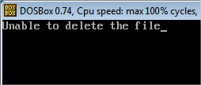
remove() function
The remove() function in C/C++ can be used to delete a file. The function returns 0 if the file is deleted successfully, Otherwise, it returns a non-zero value.
Example 1:
#include <stdio.h>
void main()
{
if (remove("demo.txt") == 0)
printf("Deleted successfully");
else
printf("Unable to delete the file");
getch();
}

Slide 27
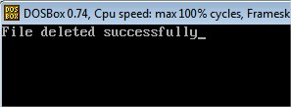
Example 2:
#include <stdio.h>
#include <string.h>
void main () {
int ret;
FILE *fp;
char filename[] = "file.txt";
fp = fopen(filename, "w");
fprintf(fp, "%s","I am an indian");
fclose(fp);
ret = remove(filename);
if(ret == 0) {
printf("File deleted successfully");
} else {
printf("Error: unable to delete the file");
}
getch();
}

Slide 28
function - feof()
The C library function int feof(FILE *stream) tests the end-of-file indicator for the given stream.
int feof(FILE *stream)
#include <stdio.h>
void main ()
{
FILE *fp;
int c;
fp = fopen("file.txt","r");
while(1)
{ c = fgetc(fp);
if( feof(fp) )
{ break ;
}
printf("%c", c);
}
fclose(fp);
getch();
}

Slide 29
FERROR()
The ferror() function tests for an error in reading from or writing to the given stream.
clearerr() clears the end-of-file and error indicators for the given stream.
#include <stdio.h>
void main ()
{ FILE *fp;
char c;
fp = fopen("file.txt", "w");
c = fgetc(fp);
if( ferror(fp))
{ printf("Error in reading from file : file.txt\n");
}
clearerr(fp);
if(ferror(fp))
{ printf("Error in reading from file : file.txt\n");
}
fclose(fp);
getch();
}

